Slide 1
Mateusz Stefanowicz
Digital experience designer
Bachelor in Software Engineering Software Developer
Software Architect

Slide 2
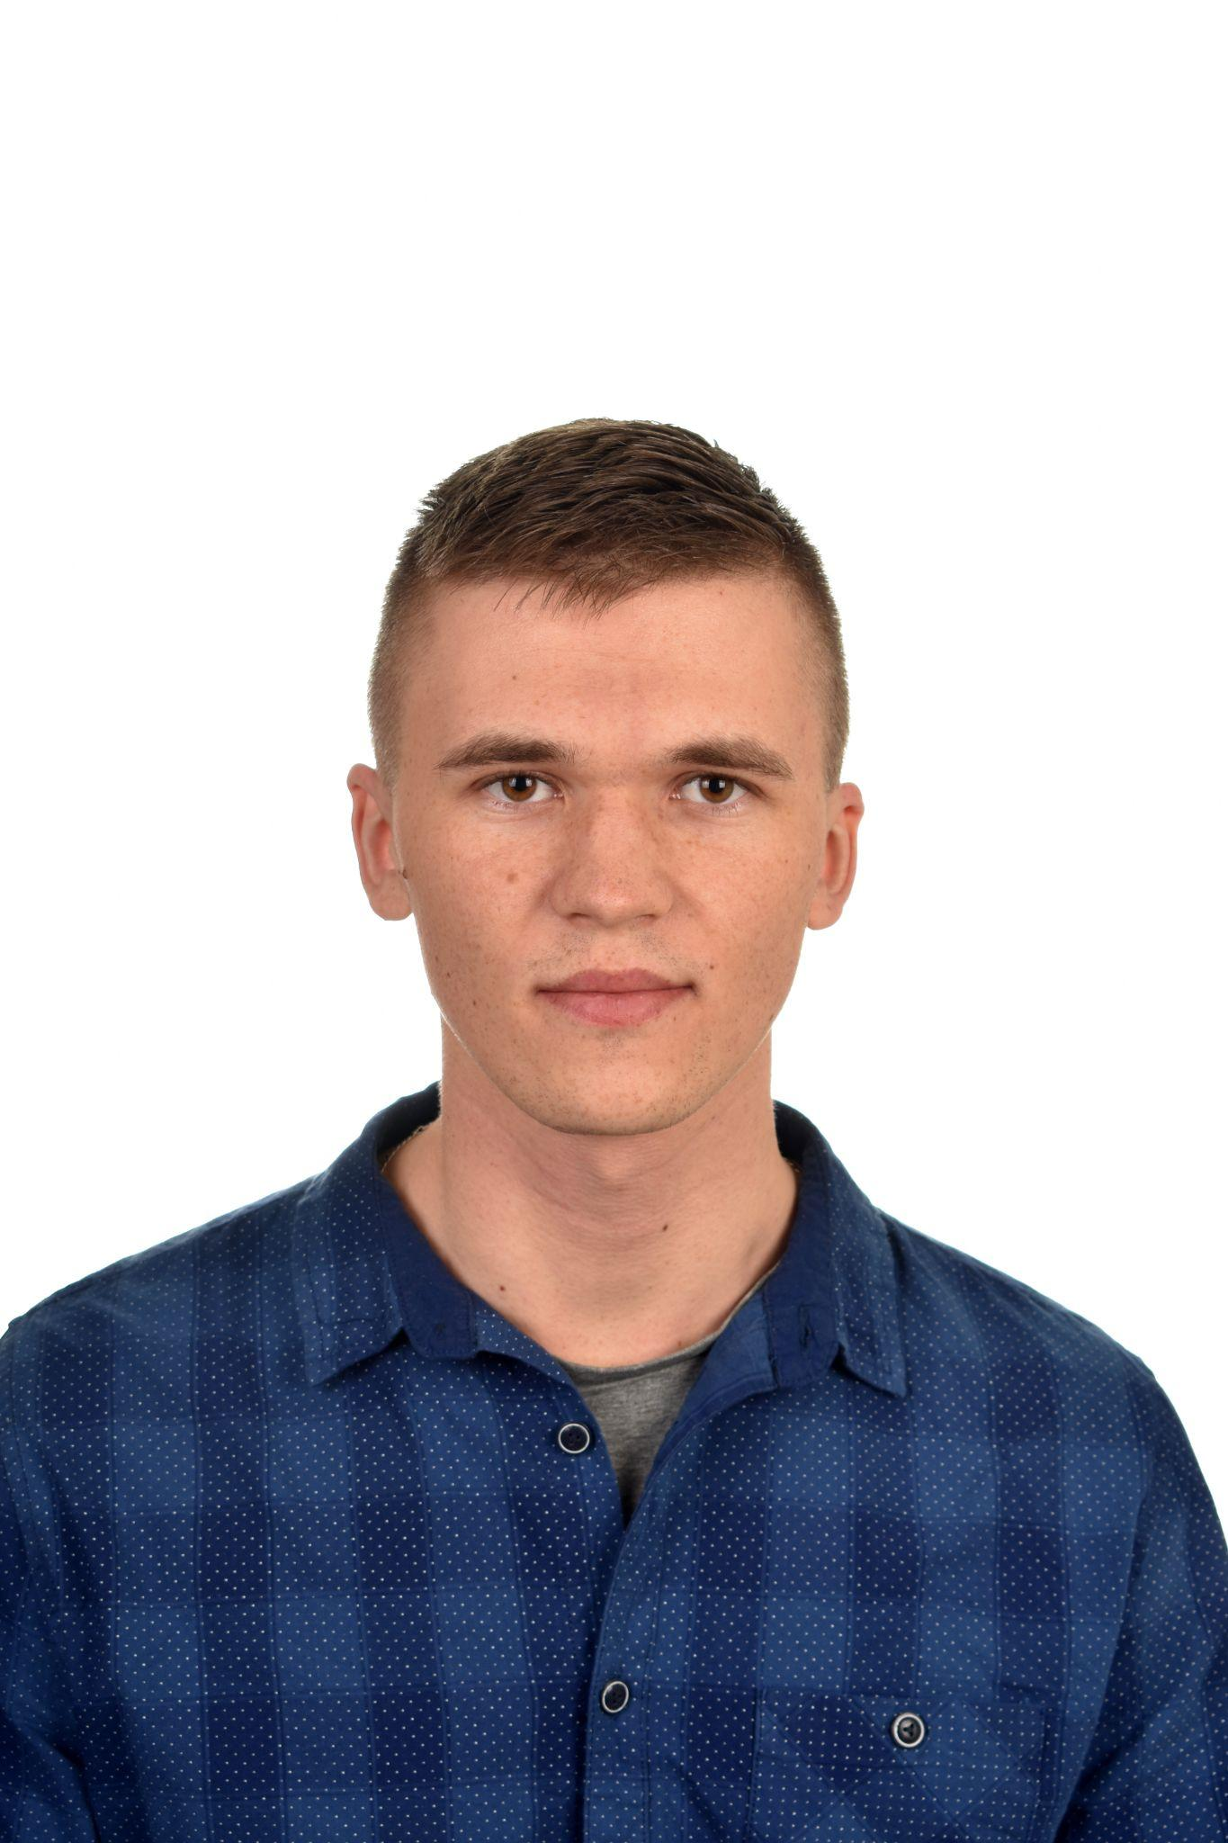
About me
I’m passionate about building great products that make people’s lives easier.

Slide 3
Skills & expertise
HTML, CSS, JS, C#, ReactJS, MongoDB
Motion design
User experience
Physical Computing

Slide 4

About project
Jirutos is built with one job in mind – tracking time. With unlimited projects, tasks, clients, and team members.
You can:
lead small or large teams
run profitable projects from start to finish.
organize your projects,
track your time,
analyze them with reports
create invoices all in one place.

Slide 5

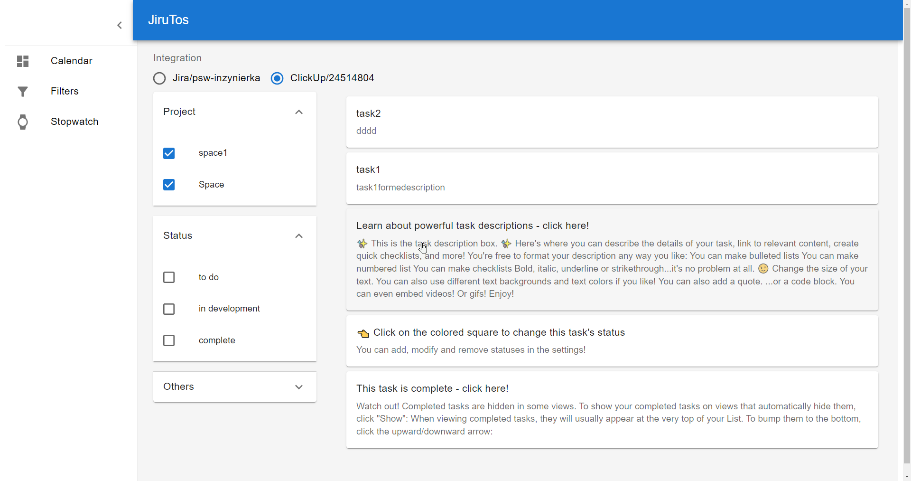

Very simple tool which helps you understand how much time you have dedicated to a task. You can better understand how your time is allocated in certain activities. Very useful to show clients or management how much time and resources were really needed for each project.

Slide 6
Web Application samples

Slide 7
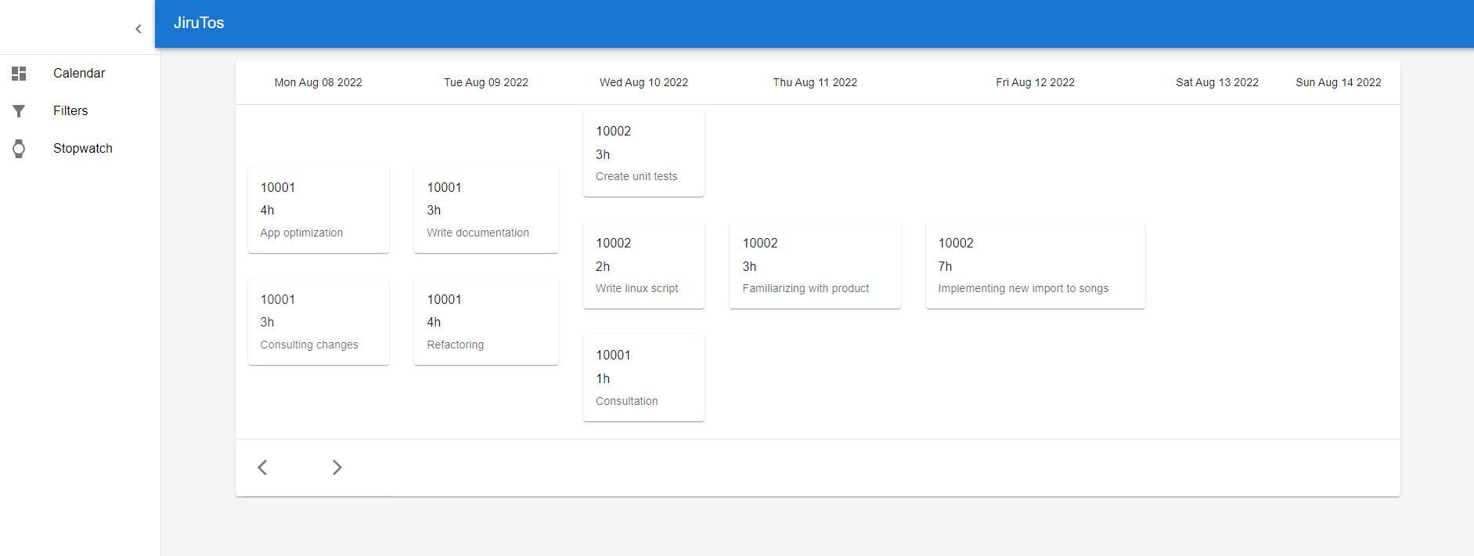

Slide 8
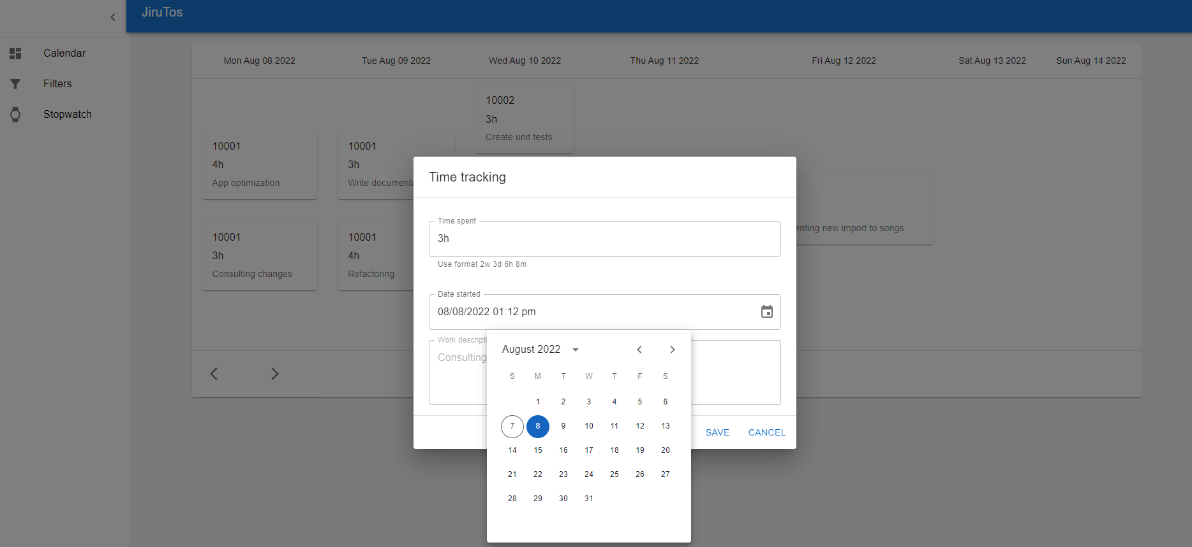

Slide 9
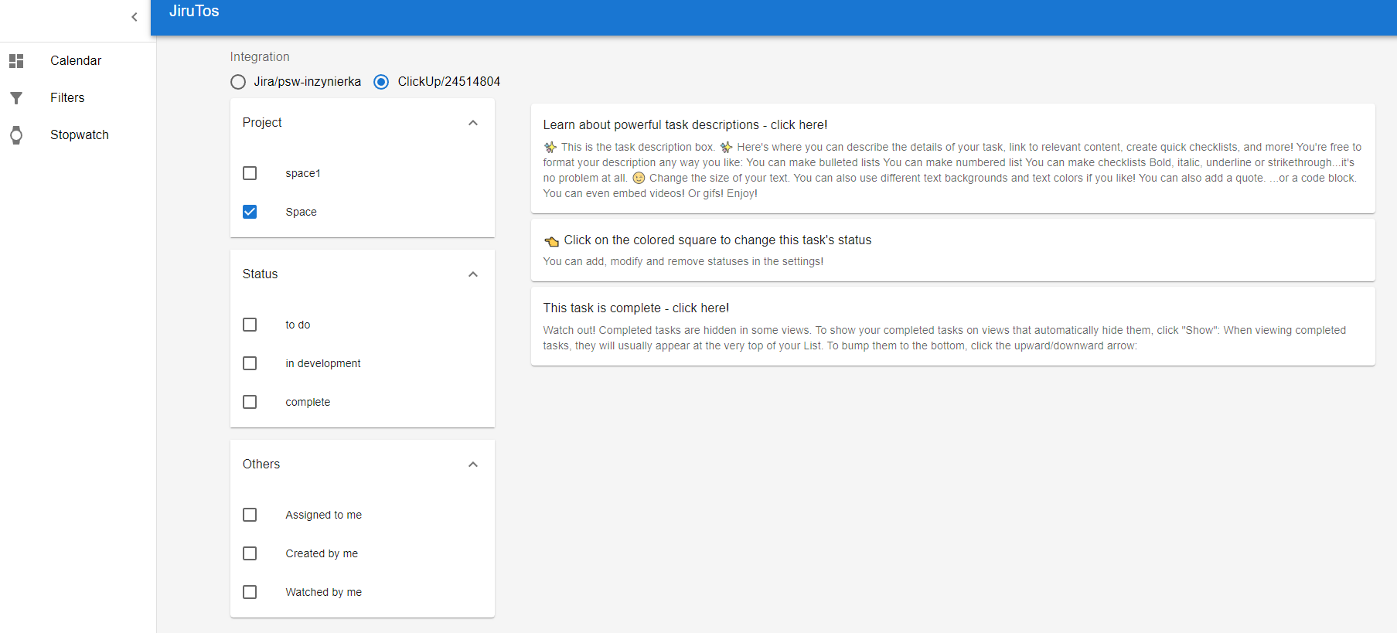

Slide 10
Users stories
“Jirutos is perfect for me, because at the end of the day, I can say how much time I spent on each task.”
— Selena Williams, Project Manager
“Mateusz it’s really good idea.You can sell it.”
— Maciej H, Academic Teacher
“In my opinion, the ideal time tracking software should be very easy to use, customizable and produce the final invoice using a user-provided template.I tried dozens of similar tools before deciding to use Jirutos. Only it matched all of our requirements.’’
— Daniel Gehriger, Software Engineer

Slide 11

Contact
Mateusz Stefanowicz
no_reply@example.com
reply@example.com
www.example.com Bank account No. 36 1020 1260 0000 0001 2013 26271

Slide 12
45%
36%
19%
Platinum
Gold
Coal
36 363 USD
12 345 USB
7 777 USB-C
45% of shares
Signature of pony from Bronks author
Private pony
Month subscription for JiruTos
36% of shares
Smile of CEO
5 students
Cup of coffee in snap of fingers
19% of shares
5 kg of sugar
2 toned of coal
Month supply of firewood
“August: This is one of the particularly dangerous months to invest. Other dangerous months are July, January, September, April, November, May, March, June, December, October and February.” — Mark Twain
56 432 USD
Marketing - 16 432 USD
Cost of lawyers - 20 000 USD
Army of students - 20 000 USD

